Slide 1
Exploring Different Kernels for SVM

Slide 2
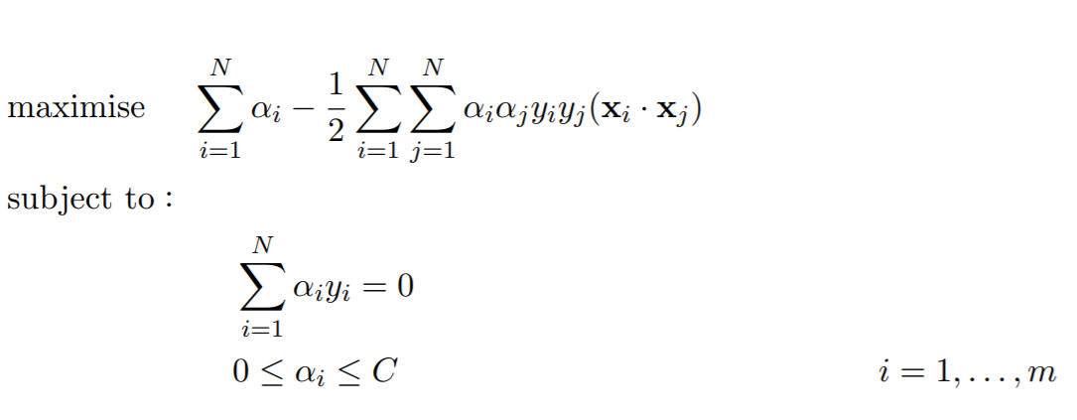
Revision
Dual Form
Linear kernel

Slide 3
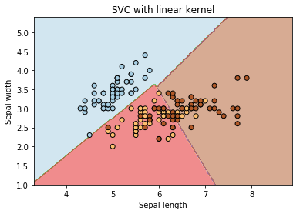
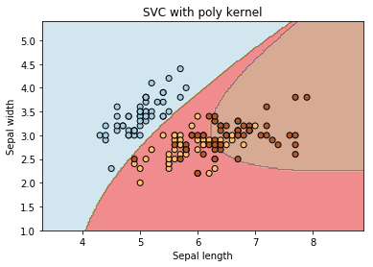
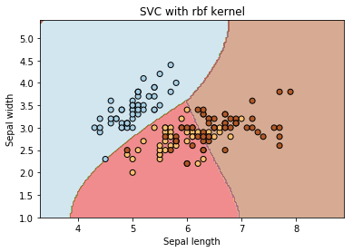
Revision
Linear Kernel
Poly kernel
RBF kernel
Linear kernel
Polynomial kernel
Rbf kernel
Reference: kernels-and-support-vector-machine-regularization

Slide 4
Data Dependent Kernels

Slide 5
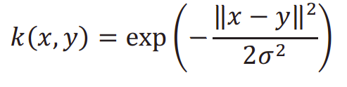
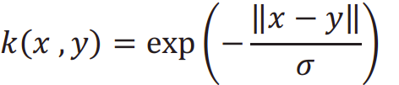
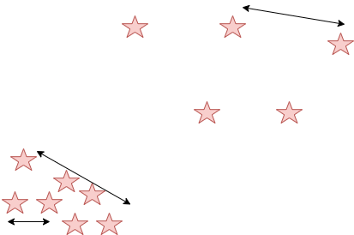
What is Data Dependent?
The task is to classify a set of points into 2 classes.
We need a metric that understands the relative closeness of data points.
Radial Kernel:
Laplacian Kernel:
How to find this using given data distribution?
Model the data as a decision tree

Slide 6
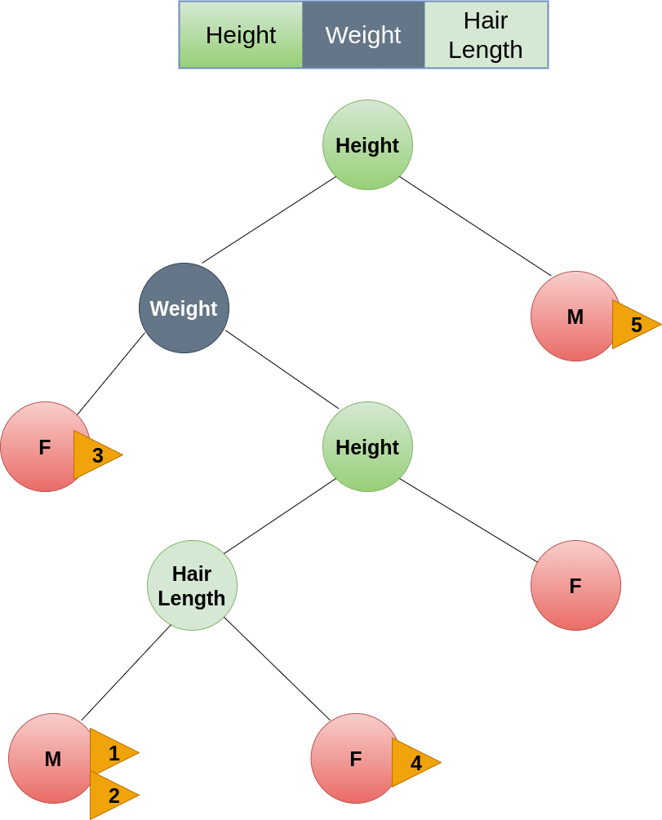
Distance Metric
When does the nodes share a leaf node?

Slide 7
Distance Metric
Isolation Tree
Can produce approximated pairwise distances between observations according to how many steps it takes on average to separate them down the tree.
Can calculate isolation kernels or proximity matrix, which counts the proportion of trees in which two given observations end up in the same terminal node.
Reference: precomputed-kernel-svm

Slide 8
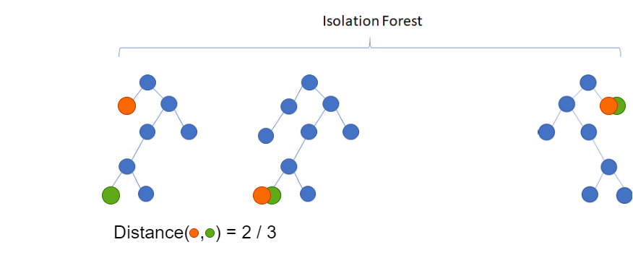
Distance Metric
When does the nodes share a leaf node?
Reference: machinelearninggeek

Slide 9
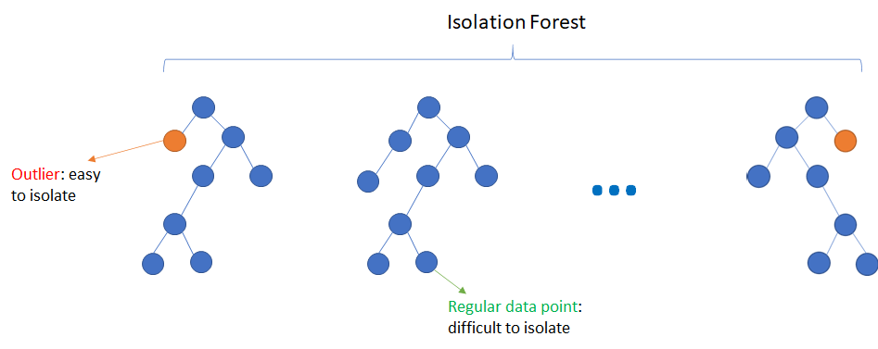
Distance Metric
What is meant by depth in a tree?
Reference: machinelearninggeek
Reference: machinelearninggeek

Slide 10
Preprocessing

Slide 11
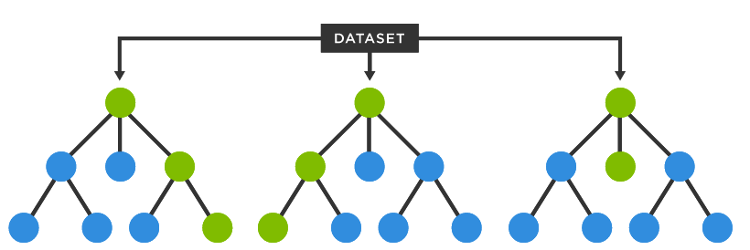
Fitting Isolation Tree
The isolation tree is constructed by fitting the training dataset.
Setting reference points
Similarity metric = 1 - distance(x)
Reference: tibco

Slide 12
Gram Matrix (Precomputed Kernel)
A nxn matrix is created from given data points using isolation tree distance metric.
x_{1,1} | x_{1,2}
x_{2,1} | x_{2,2}
x_{3,1} | x_{3,2}
x_{4,1} | x_{4,2}
dis(x₁,x₁) | dis(x₁,x₂) | dis(x₁,x₃) | dis(x₁,x₄)
dis(x₂,x₁) | dis(x₂,x₂) | dis(x₂,x₃) | dis(x₂,x₄)
dis(x₃,x₁) | dis(x₃,x₂) | dis(x₃,x₃) | dis(x₃,x₄)
dis(x₄,x₁) | dis(x₄,x₂) | dis(x₄,x₃) | dis(x₄,x₄)

Slide 13
Results

Slide 14
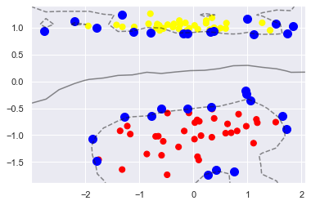
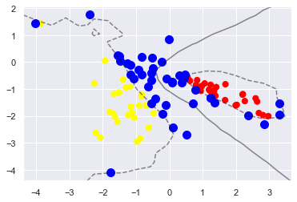
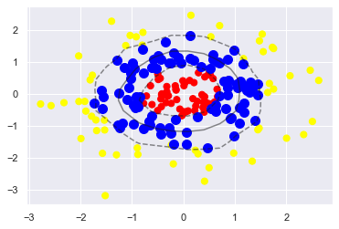
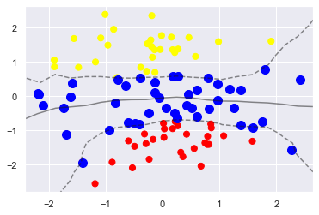
Isolation kernel in different datasets

Slide 15
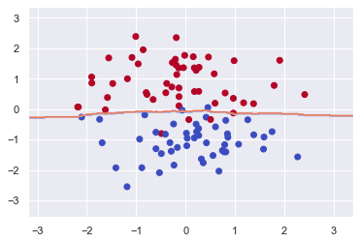
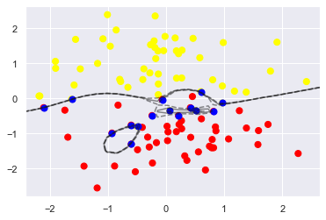
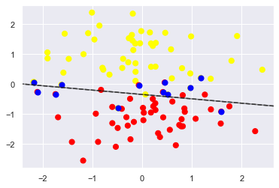
Isolation Kernel (Comparison)
Isolation
Kernel
Laplacian
Rbf
Linear

Slide 16
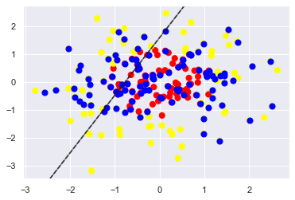
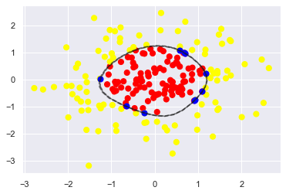
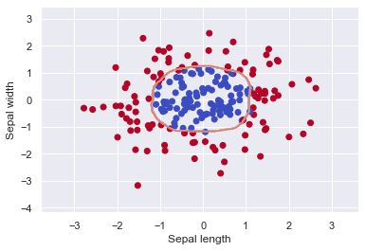
Linear
RBF
Laplacian
Isolation
Kernel

Slide 17
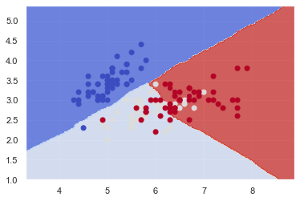
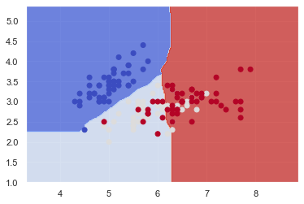
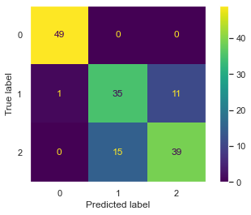
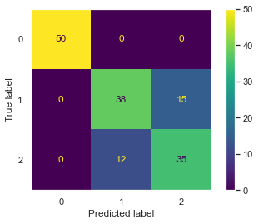
Accuracy Comparison (Iris dataset)
Isolation
Kernel
Laplacian

Slide 18
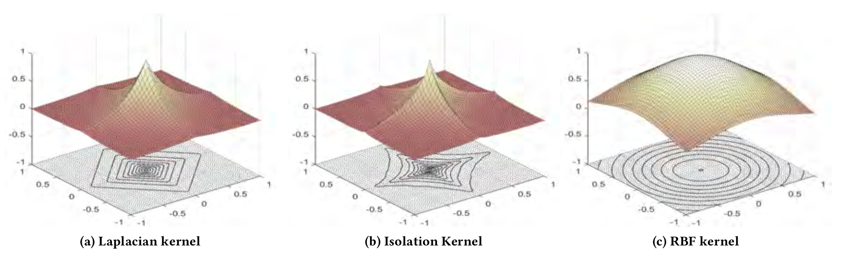
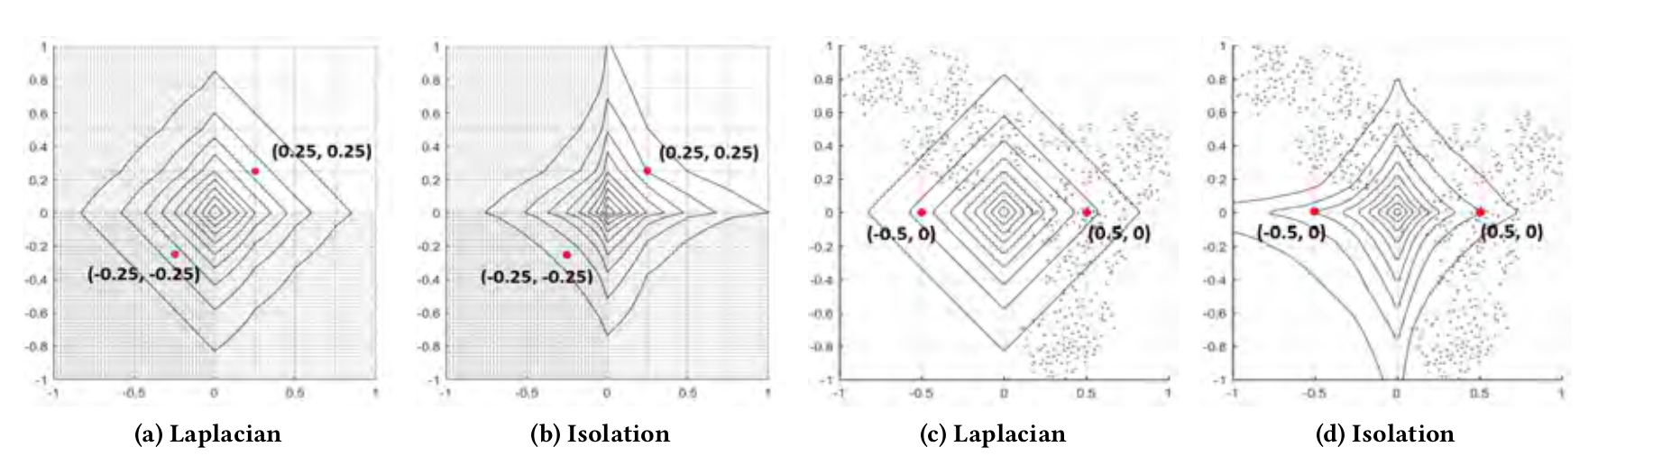

Slide 19
Future Scope

Slide 20
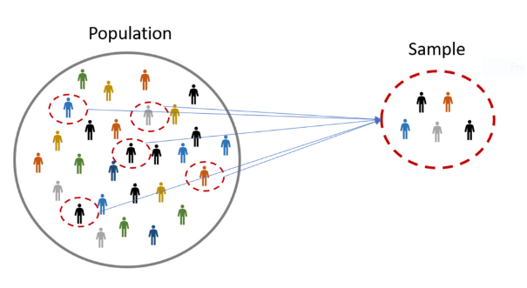
Sampling and Semi-Supervised learning
Reference: medium.com

Slide 21
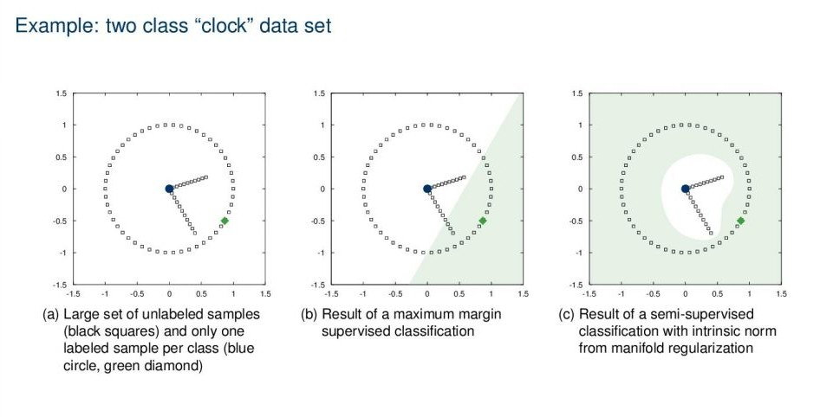
Motivation
Reference: laplacian-support-vector-machines

Slide 22
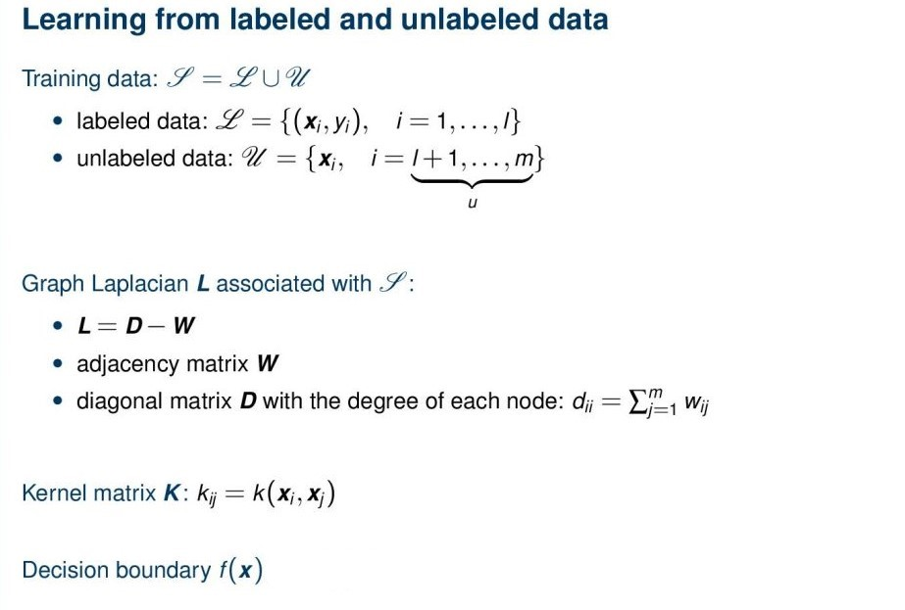
Laplacian SVM
Notes:
https://lme.tf.fau.de/lecture-notes/lecture-notes-pr/lecture-notes-in-pattern-recognition-episode-28-laplacian-support-vector-machines/

Slide 23
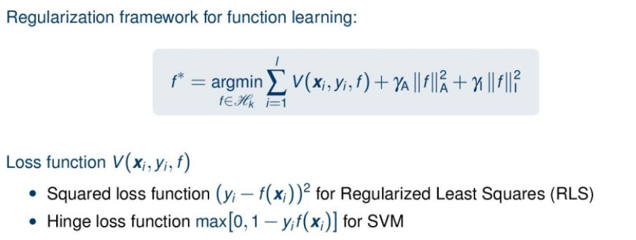
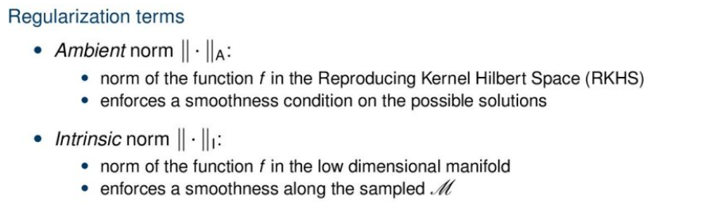
Optimization problem

Slide 24
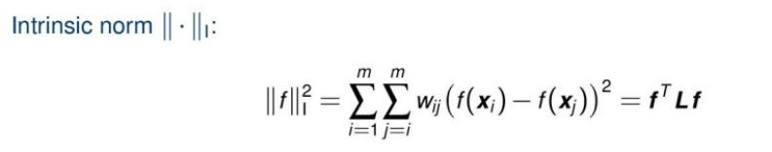
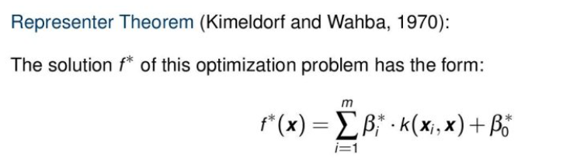
Optimization problem

Slide 25
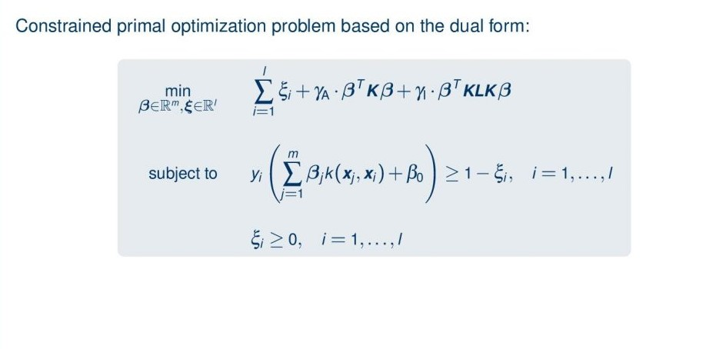
Primal Form

Slide 26
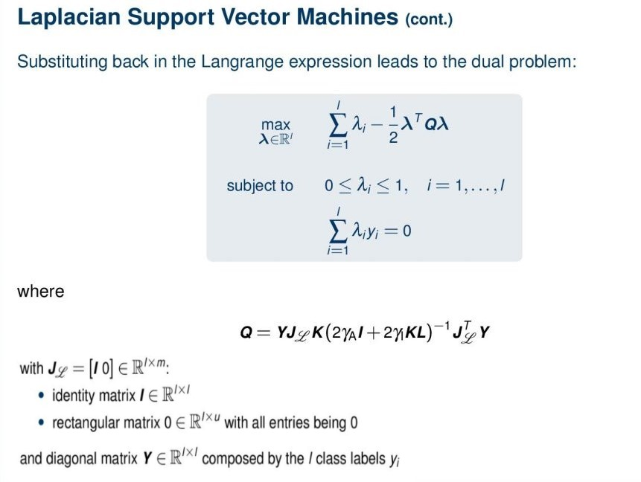
Dual Problem

Slide 27
Time Complexity
n: Number of datapoints
m: Dimension of data
t: Number of decision trees
Isolation kernel
Laplacian SVM + Isolation kernel
Decision Tree: O(m * n * Logn)
Isolation Forest: O(t * m * n * Logn)
Gram matrix: O(n * n)
n ~ 1000, m ~ 60, t = 100
TC = O(6.10⁷+10⁶)
Sample a small set: S = (l, n-l)
Decision Tree: O(m * l * Logn)
Isolation Forest: O(t * m * l * Logn)
Gram matrix: O(s * s), Laplacian matrix: O((n-s) * (n-s))
n ~ 1000, s ~ 100, m ~ 60, t = 100
TC = O(6.10⁶+8.10⁵)
Lagrange multipliers in SVM also reduced
N(1000) to l(100)

Slide 28
References

Slide 29
References
Kai Ming Ting, Yue Zhu, and Zhi-Hua Zhou. 2018. Isolation Kernel and Its Effect on SVM. In Proceedings of the 24th ACM SIGKDD International Conference on Knowledge Discovery & Data Mining (KDD '18). Association for Computing Machinery, New York, NY, USA, 2329–2337. https://doi.org/10.1145/3219819.3219990
https://lme.tf.fau.de/lecture-notes/lecture-notes-pr/lecture-notes-in-pattern-recognition-episode-28-laplacian-support-vector-machines/

